Slide 1
Travel Bug
A travel planner
Sumedh shah
Noopur Latkar
Rohit sanyal

Slide 2



Team Non-Interpreters
Rohit Sanyal
rohitsan@andrew.cmu.edu
Sumedh Shah
sumedhns@andrew.cmu.edu
Noopur Latkar
nlatkar@andrew.cmu.edu

Slide 3
Problem
Customer Pain
Fetch flights on multiple websites to compare and analyze the best option
Explicitly look for top attractions on the internet
Check tourist spot locations to plan an itinerary
Get weather forecast from another application and map dates accordingly

Slide 4
Vision
To assist users in planning travel with a comprehensive, integrated solution
Cost-efficient flight options
Weather forecast through travel dates
Top tourist attractions in destination city
Day-wise itinerary by geo-clustering tourist spots
Curated to match the user’s travel dates with the best options available

Slide 5
Libraries used
Pandas
Numpy
Web Scraping
BeautifulSoup4
Selenium
GUI
PyQt5
Geo-spatial Clustering
Scikit-learn
Geopandas
Matplotlib
Seaborn
Shapely

Slide 6
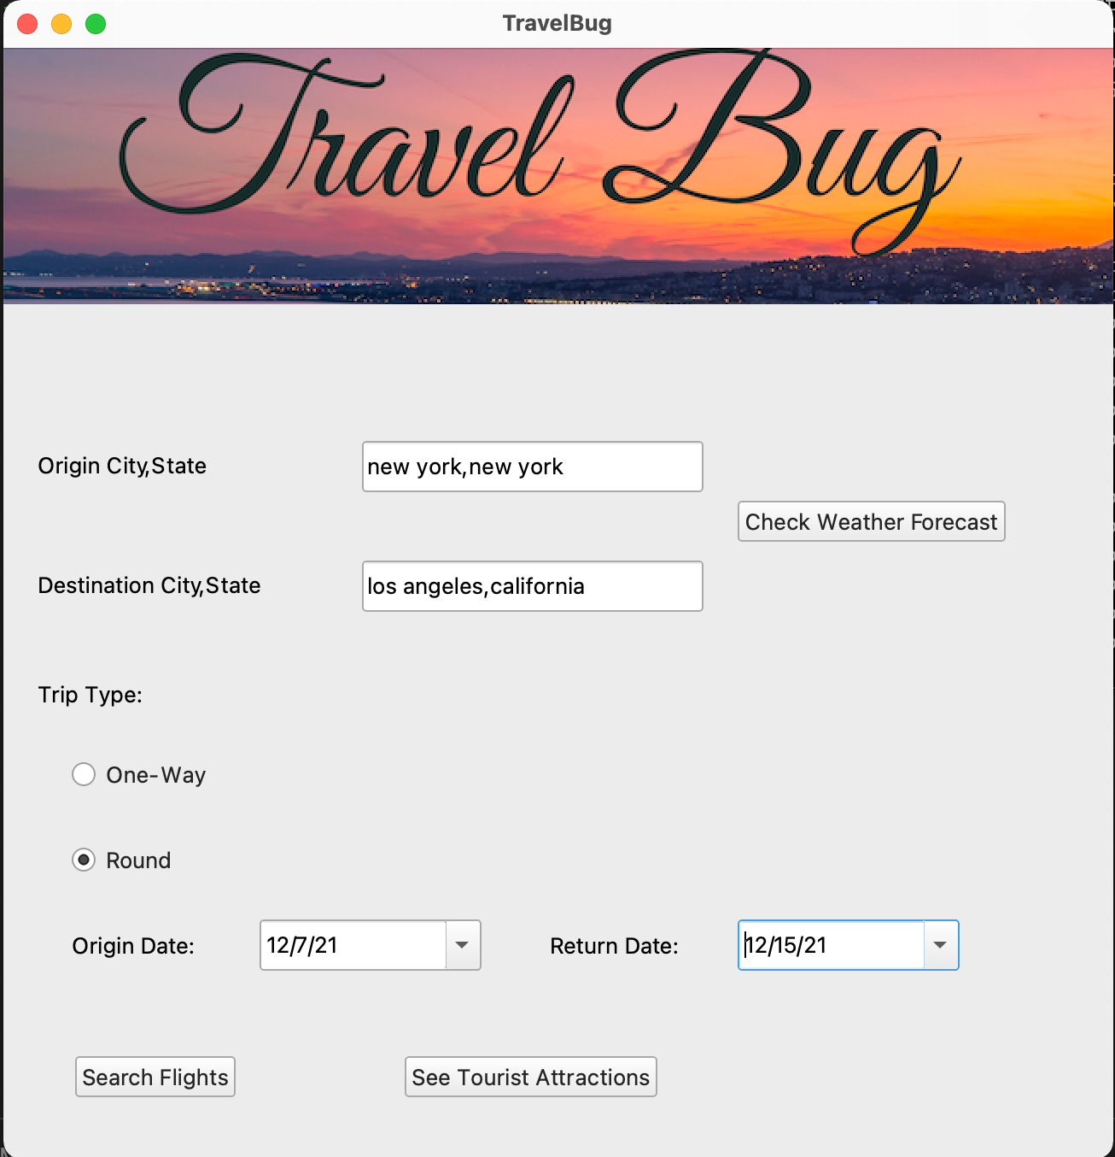
Valid User Input
Look up CSV for source and destination city state authenticity
Reference :
US-cities (28,400 entries)
Origin Date cannot be older than current date
Return Date cannot be older than Origin Date

Slide 7
Flights
Web scraping using Selenium and BeautifulSoup
Filtering on best flight options available
Retrieving all flight details for both journeys
Sorted on price (cheapest -> most expensive)
Resources
KAYAK (online travel agency and metasearch engine)
US-Airports CSV (containing 28,000 entries)

Slide 8
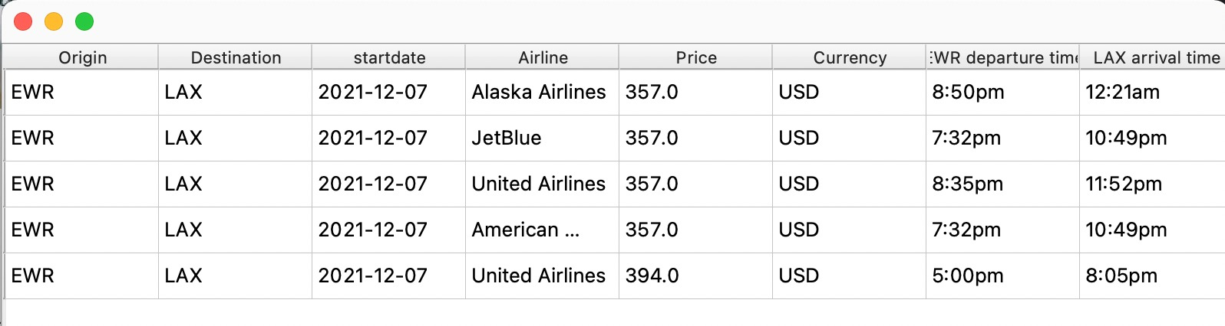
Flight Options
One-Way Trip

Slide 9
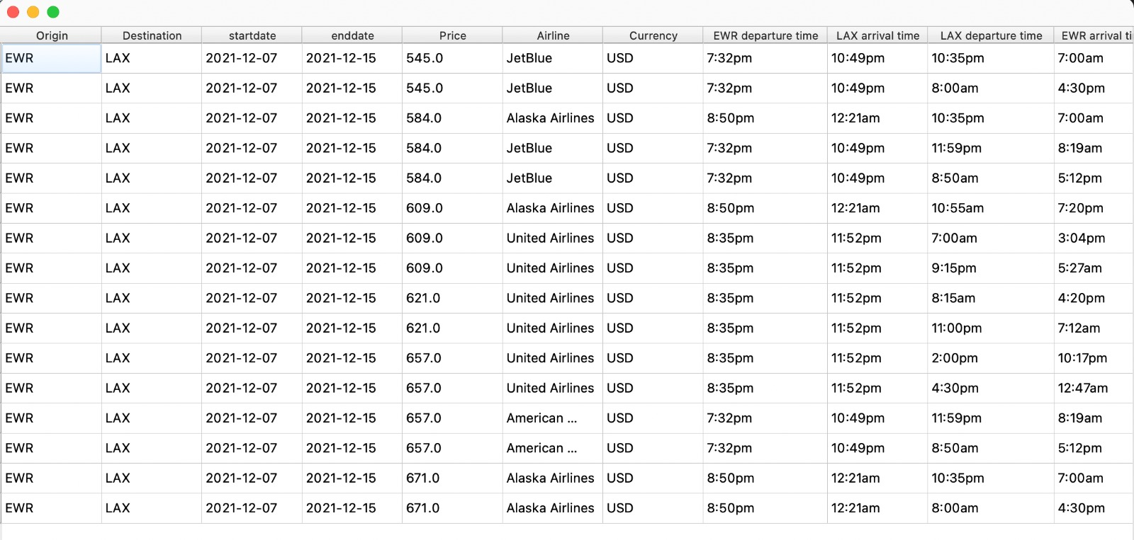
Flights Options
Round Trip

Slide 10
Weather Forecast
API to get forecast for next 5 days
Description and status with interactive logos
Temperature parameters (min, max, avg)
Resources
OpenWeatherMap API (global weather model)

Slide 11
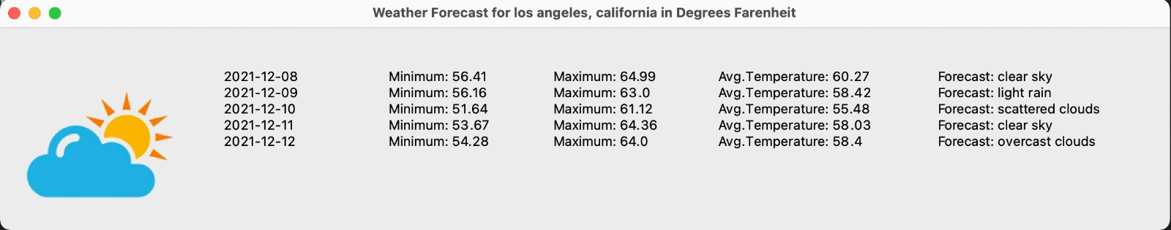
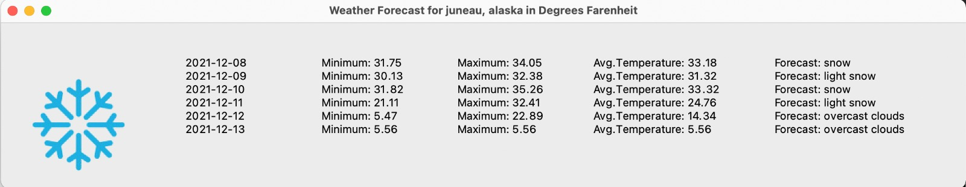
Weather Forecast

Slide 12
Tourist Attractions
Fetching top tourist attractions from destination city through web scraping
Getting latitude, longitude of each tourist spot using API
Geo-spatial clustering using k-means algorithm
Resources
Website – Attractions of America
OpenStreetMap API for raw geodata

Slide 13
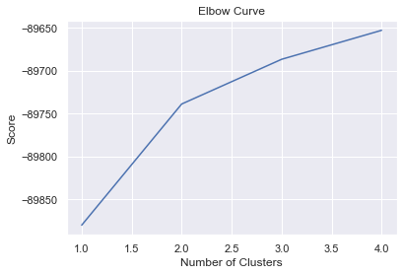
Elbow Curve
Each inflection point differentiates clusters
Runs k-means clustering on dataset for range k
Calculates Sum of Squared Errors (SSE) for each k

Slide 14
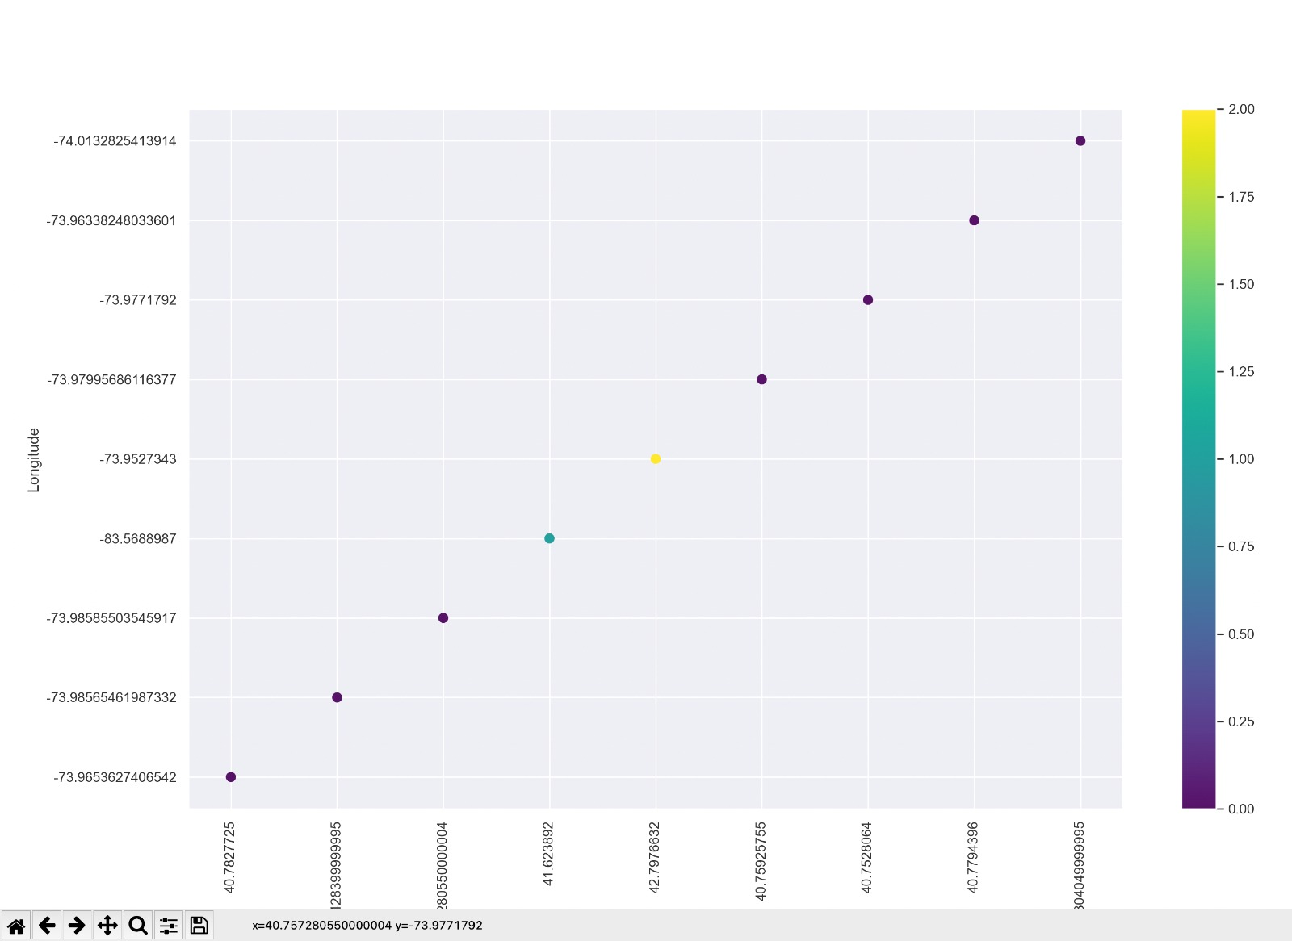
Geo-spatial Clustering
Assigned cluste labels based on tourist spot location
Designated colors depict unique clusters

Slide 15
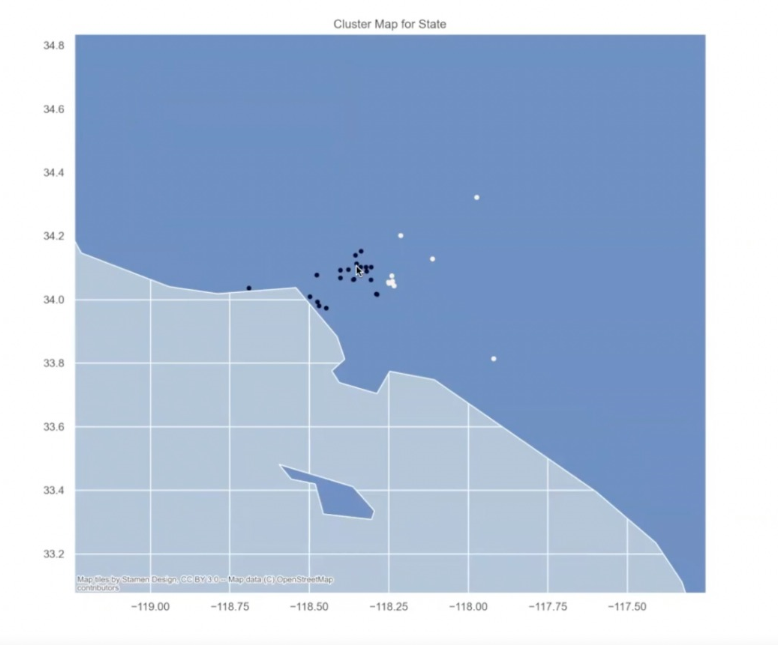
Geopandas
Overlaying clustered locations over state map for better visualization
Generated from shp files for 50 states

Slide 16
References
Validating User input
https://simplemaps.com/data/us-cities
Weather API
https://openweathermap.org/api
Flight Scraping
https://www.kayak.com/flights
https://towardsdatascience.com/scraping-flight-data-using-python-e71b97e859d3
https://data.humdata.org/dataset/ourairports-usa
Geo-spatial clustering
https://levelup.gitconnected.com/clustering-gps-co-ordinates-forming-regions-4f50caa7e4a1
https://www.attractionsofamerica.com/attractions/
https://nominatim.openstreetmap.org/ui/search.html

Slide 17
Thank you!

